Slide 1
Operating Systems
IPC: Inter-processes Communication
Vassilis Markos,
Mediterranean College
Week 10

Slide 2
Concurrency

Slide 3
Another Idea…
Why did the above idea fail?
Mostly because we did not work carefully enough, since there are cases where both processes mutually exclude one another from accessing their shared counter.
So, what if we:
  First waited on each process for the other and;
  Then change the status from pending to active.
Open and run source/ipc_005.c
  What do you observe?
  Does this work? (Run it 10+ times)

Slide 4
Desperation
So far, nothing has proved any useful, either because we might modify the shared resource simultaneously or because of mutual exclusion or because of starvation of one process or…
Can you think of another idea?
If not, consider inspecting source/ipc_006.c
  What is the idea in there?
  Do you expect it to work?
  Run the program a few times (20+) to find out.
  So, does it really work?

Slide 5
Peculiarities…
Consider the following scenario (each line contains the command each thread will run next, bold text corresponds to actually run commands):
Parent | Child
counter->c (True) | counter->c
counter->p = False | counter->p (True)
counter->p = False | counter->c = False
counter->p = True | counter->c = False
counter->c (False) | counter->c = False
counter->c (True) | counter->c = True
counter->c (True) | counter->p (True)
the same → loop!

Slide 6
Peculiarities…
This is a scenario which, if repeated indefinitely, will result into a deadlock - no one enters their critical section.
You might say that this is rare, but, is it?
  One server
  10,000 clients (a modest company)
  How many requests per hour? Day? Month?
  → There is plenty of room in real life cases for such things to happen.
This is a hard thing about debugging concurrent programs: You can’t just “unit test” them as sequential ones. You have to prove their correctness with pen and paper (unfortunately…)

Slide 7
Bad Idea + Bad Idea == ?
What if we try to combine two bad ideas to get a good one?
  This is usually not a good idea, just in case you wondered…
  However…
So, as we have seen so far:
  Using a single “turn” flag solves the problem by effectively breaking concurrency, hardcoding the order threads execute → risk of starvation.
  Using two flags, one per thread, to allow for one thread taking over the other in case of starvation still does not solve the problem.
  Making threads respect first ask and then enter their critical section does not address the problem either…
  Nor does making up our mind regarding whether we should enter our critical section or not…

Slide 8
Bad Idea + Bad Idea == ?
However, the last solution, was the most correct, in the sense that things break up in just one case.
So, it might make sense to try to fix that.
Can you mix up ideas from last time to create a new solution that also addresses this subtle case?
  Hint 1: Use the code found in source/racing_006.c as a starting point.
  Hint 2: Modify the flag updating parts a bit, looking up what happens in source/racing_00x.c for x = 2, 4, and 5.
  Hint 3: Use turns alongside the idea presented in source/racing_006.c

Slide 9
Dekker’s Algorithm
Dekker's algorithm is one of the earliest algorithms designed to solve the critical section problem for two processes.
Shared variables:
  flag[2]: An array of two boolean flags, one for each process. flag[i] indicates whether process i wants to enter the critical section.
  turn: An integer variable indicating whose turn it is to enter the critical section.
In pseudocode (next slide).

Slide 10
Dekker’s Algorithm
// Process 0
while (true) {
flag[0] = true;
while (flag[1]) {
if (turn == 1) {
flag[0] = false;
while (turn == 1) {
// Busy wait
}
flag[0] = true;
}
}
// Critical Section
turn = 1;
flag[0] = false;
// Remainder Section
}
// Process 1
while (true) {
flag[1] = true;
while (flag[0]) {
if (turn == 0) {
flag[1] = false;
while (turn == 0) {
// Busy wait
}
flag[1] = true;
}
}
// Critical Section
turn = 0;
flag[1] = false;
// Remainder Section
}

Slide 11
Dekker’s Algorithm
A process sets its flag to indicate its intention to enter the critical section.
If the other process's flag is set, it checks the turn variable to determine who should enter the critical section.
The process with the turn enters the critical section.
After exiting the critical section, the process sets its flag to false and sets the turn variable to give the other process the turn.
Dekker's algorithm ensures mutual exclusion, progress, and bounded waiting.
It uses busy waiting, which can be inefficient, e.g., for long critical sections.
Modern synchronization primitives like semaphores and mutexes are often preferred for their efficiency and ease of use.
While Dekker's algorithm is a classic example of a mutual exclusion algorithm, there is better stuff out there…

Slide 12
Bad Idea + Bad Idea == Very Good Idea
Can you implement the above in C?
  Take some time to do so!
Check out source/racing_007.c:
  Is this correct – compare it to the pseudocode above.
  Run it a few times (~10).
  So, does it really work?

Slide 13
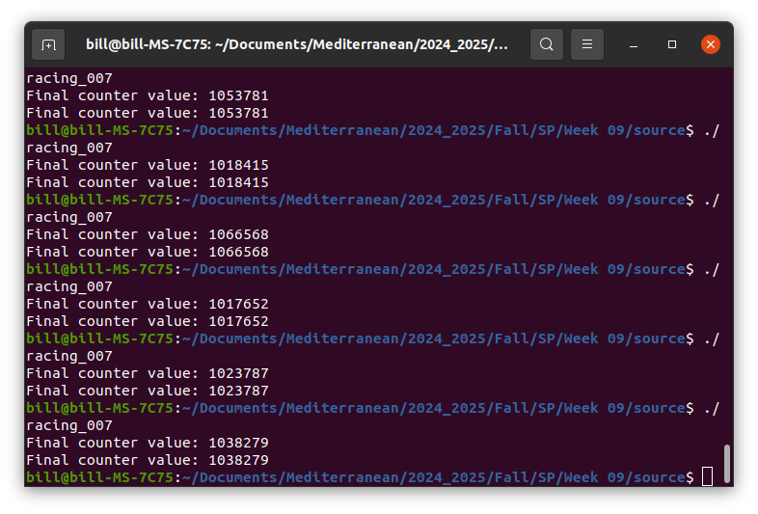
Typical Output

Slide 14
static And volatile
This is supposed to work in theory, as there is no way to neither lead a process to starvation nor enter the critical section at the same time…
How can this fail so badly?
Besides RAM, a variable value can also reside in other places, including CPU cache memory.
How to prohibit using cached values?
In C, we can declare a variable as:
  volatile, which means that the compiler will guarantee that the value of that variable will be read from and written to each time it has to be used.
  static, which means that the variable will be visible only within its definition scope.
Check source/racing_008.c and run it. Does it work?

Slide 15
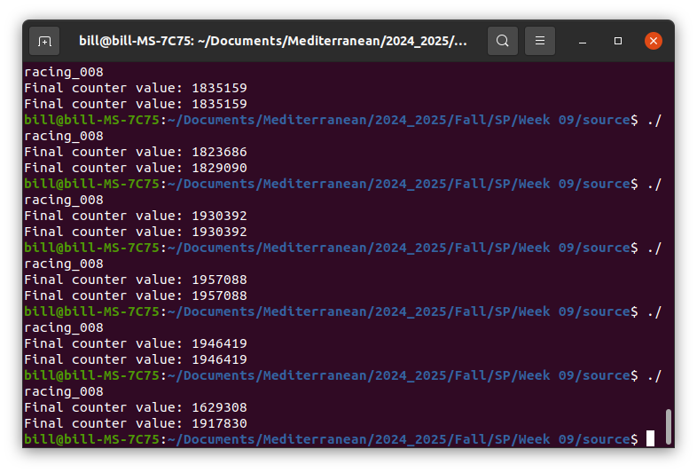
Typical Output

Slide 16
What Is Going Wrong?
Hit lscpu on your machine.
What is the output?
Architecture: x86_64
CPU op-mode(s): 32-bit, 64-bit
Byte Order: Little Endian
Address sizes: 39 bits physical, 48 bits
virtual
CPU(s): 16
On-line CPU(s) list: 0-15
Thread(s) per core: 2
Core(s) per socket: 8
…

Slide 17
Τhe Source Of All Errors…
Hit lscpu on your machine.
What is the output?
Architecture: x86_64
CPU op-mode(s): 32-bit, 64-bit
Byte Order: Little Endian
Address sizes: 39 bits physical, 48 bits
virtual
CPU(s): 16
On-line CPU(s) list: 0-15
Thread(s) per core: 2
Core(s) per socket: 8
…

Slide 18
Dekker And Cores
Dekker’s algorithm is a nice and elegant way to solve the Critical Section problem.
However, it was devised when things ran on a single core.
Inter-core communication is a relatively new thing (compared to Dekker’s algorithm), which allows cores to communicate and exchange information.
Most of the times, simple operations will perform as if they were “atomic” on a single core:
  e.g., counter->i++ in our case should be one such example.
However, in the realm of millions of iterations, one core might manage to get into the other’s cycle while a thread there is in its own critical section.

Slide 19
Dekker And Cores
Dekker’s algorithm cannot actually work on multi–cored machines, because, most of the times, such systems implement weak consistency memory:
  All accesses to synchronization variables are seen by all processes (or nodes, processors) in the same order (sequentially) - these are synchronization operations. Accesses to critical sections are seen sequentially.
  All other accesses may be seen in different order on different processes (or nodes, processors).
  The set of both read and write operations in between different synchronization operations is the same in each process.

Slide 20
However…
Hit man taskset
How can you use this to verify that our implementation of Dekker’s algorithm works?
Play around and find out!
Hint: use taskset --cpu-list 1 ./racing_007
  You might need to change the CPU number if working on a VM.
What do you observe?
This is actually a really nice way to make your program run in a single CPU core, in case you need to verify such behaviour — you can also provide a full list of CPU cores to run your process on.

Slide 21
Further Reading
Regarding static, volatile and much about C:
  https://www.open-std.org/jtc1/sc22/wg14/www/docs/n1570.pdf
Regarding Dekker’s algorithm on one and multiple cores, consider reading this excellent article and the discussion below:
  https://jakob.engbloms.se/archives/65
Regarding how to actually implement Dekker’s algorithm on multi-core machines, you will need first to study some assembly:

Slide 22
The Bakery Algorithm

Slide 23
What About Bakeries?
Imagine a bakery with multiple customers. Each customer wants to place an order at the counter (to get Christmas treats, let’s say)
To avoid chaos and ensure fairness, what should the bakery do?
A simple yet efficient idea:
  Each customer takes a number ticket from a dispenser. The number is unique and larger than any number currently held by other customers.
  Customers wait in line, comparing their ticket numbers with others.
  The customer with the smallest number approaches the counter and places their order.
  After placing the order, the customer leaves the counter, allowing the next customer with the smallest number to approach.

Slide 24
Bakery Algorithm In Pseudocode
int number[N]; // Number chosen by each process
boolean choosing[N]; // Indicates if a process is choosing a number
while (true):
// Choosing a number
choosing[P] = true;
number[P] = max(number[0], number[1], ..., number[N-1]) + 1;
choosing[P] = false;
// Waiting for other processes
for (int q = 0; q < N; q++):
while (choosing[q]):
// Busy wait
while (number[q] != 0 && (number[q] < number[P] || (number[q] == number[P] && q < P))) {
// Busy wait
// Critical Section
// Exiting the critical section
number[P] = 0;

Slide 25
Bakeries And C
Can you implement this using C?
  Take some time to do so!
Execute it a couple of times.
Does it work as expected?
What else are we missing for an actual production ready implementation?
Exception handling!
  Things might go wrong in ways we can predict or at least expect, so we should make sure we capture those cases and handle them appropriately.

Slide 26
Fun Time!

Slide 27
Much Like Your Assignment…
Create a simple C function named foo() that:
takes a string as an argument;
randomly permutes its characters, stripping out any whitespace, and;
returns the mutated version of the string.
Using this as a mock “service” implement IPC between a parent process which shares a user provided string and a child process which mutates that string using foo() and returns the mutated version to the parent process. You should implement this in the following three different ways:
Using pipes.
Using shared memory.
Using message queues.

Slide 28
Nasal Demons
It is a well known fact that the C compiler can do a lot of stuff at its own will and discretion. One of the most popular capabilities of the C compiler is that of making demons fly out of your nose. Your mission for this exercise is to:
Find out what is the relationship between nasal demons and the C compiler and summarise your findings.
Try to reproduce this behaviour — in the context of its original first appearance in this world, do not try to manipulate demons through your nose in any realistic manner!

Slide 29
What About The Critical Section Problem?
Today we discussed about a really new problem, the Critical Section Problem. So far, we have not found a convincing solution to it, albeit we have explored four alternatives that, under certain restrictions, provide some partial solutions.
So, can you think how we might take advantage of the strengths of the solutions we have presented so far to address the Critical Section Problem?
Implement a full solution to the Critical Section Problem in C using system calls, in the context of the shared counter we have explored today.

Slide 30
C And Inline Assembly
This is a self–study exercise regarding C and inline assembly (don’t worry, you will not be assessed on that!) Below you can find some starting pointers on the use of inline assembly in C:
https://developer.arm.com/documentation/den0013/d/Memory-Ordering/Memory-barriers
Try to implement Dekker’s algorithm by using appropriate inline assembly instructions and properly implementing memory barriers to prohibit CPU cores from accessing the critical sections of other cores.

Slide 31

Any Questions?
Don’t forget to fill-in the questionnaire (check right)
https://forms.gle/aj7pYsK1ksufD6xYA

